Slide 1

PRE AND POST TOUR PROGRAMME
2023

Slide 2

Our incredible PRE AND POST TOUR PROGRAMME provides you with a unique opportunity to host delegates (Buyers, Press, or Exhibitors) for a TWO NIGHT MINIMUM stay either before or after Do Not Disturb 2023. Allowing them to experience your property ﬁrst hand while generating added exposure for your brand.
This is a good opportunity to gain exclusive access to leading travel specialists before the show or to develop relationships after the show.
Pre and Post Tours will be listed on the Do Not Disturb website, including a picture, a description, and a link to your website. We will also be using our pre-show communications and e-shots to showcase this year’s edition of offers.
Follow the “how to guide,” on the next slide to submit your Pre and/ or Post Tour for 2023.

Slide 3
Please download this file to your computer before editing!
Use the template below; on slides 5 – 7 (refer to slides 9 – 11, as an example)
Use an exciting and catchy name for your tour
Provide a short description about your property and what people can expect to indulge in during their stay
Make sure that your selected photographs are at least 1MB
Add dates for your Pre and/ or Post Tour (NB: your tour should not fall on Do Not Disturb show days: 13 – 17 November 2023)
Once you have completed the template, please delete the guide text found in the template as well as the last 4 slides which contain the example tour
Please submit your offer at the following
*Please note, the following:
Packages offered must incorporate activities and be either FOC or include a significant trade discount.
You are allowed to collaborate with other registered Do Not Disturb 2023 exhibitors.
Buyers and press need to use #DNDOnTour2023, when booking. Please contact us, should you want to confirm if someone is a registered Do Not Disturb 2023 attendee.
Should you have any questions, please contact xavier@thisisbeyond.com

Slide 4

INSERT PROPERTY NAME HERE
INSERT NAME OF OFFER HERE
Please insert an image below, please note that this image will be the one that appears on our webpage – advertising your offer. Ensure that this image size is a minimum of 1MB.
Provide a description of your property and offer here
xxxxxxxxxxxxxxxxxxxxxxxxxxxxxxxxxxxxxxxxxxx

Slide 5
When?
How much?
(please include currency and indicate whether it is price per stay or per night)
Buyers
Press
Exhibitors
What’s included?
What’s excluded?

Slide 6
Please insert images in the boxes below:
Contact
Name
Contact number (including dialling code)
Contact email address
Web address

Slide 7
EXAMPLE TEMPLATE

Slide 8
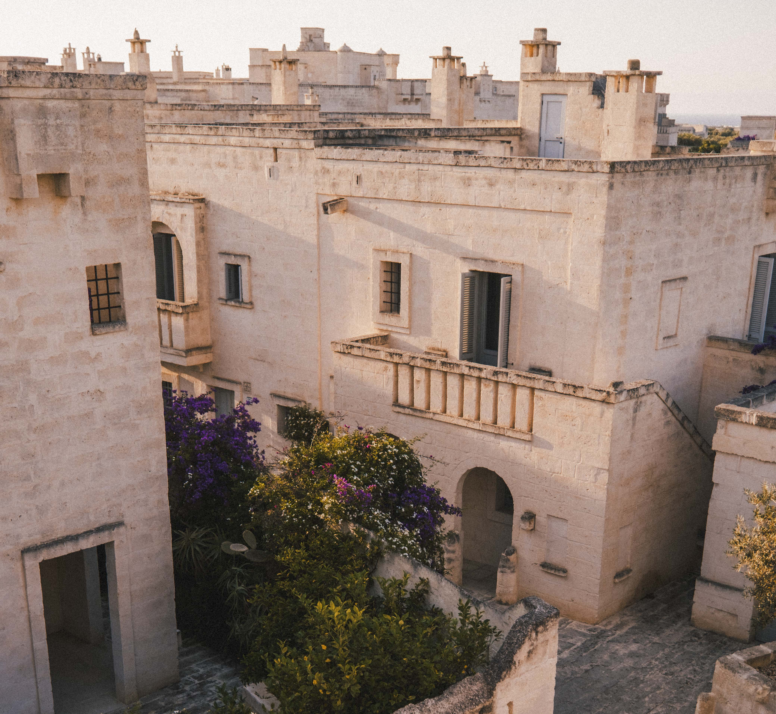
BORGO EGNAZIA
BORGO DREAMING
Borgo Egnazia weaves together a journey through all the magical highlights of Puglia. This all inclusive four night, five­‐day journey starts with a visit to the quaint old town of Puglia. Here you will experience a true Italian meal. Get whisked across the Apulian landscape to discover the natural beauty of this region. Stop at small coastal villages and towns that make up the heritage of this region.
Spend a day exploring the vast stretches of pristine beaches where you will encounter stunning sites, intriguing culture and fascinating geology.
Spend a day at Vair Spa and take advantage of the Roman Thermal Baths, Floatation Tank and beautiful pools.

Slide 9
When?
6 – 12 November 2023
19 – 25 November 2023
How much?
Buyers
Press
Exhibitors
Complimentary
€50 per night
N/A
What’s included?
What’s excluded?
Full Board Accommodation
All meals
Spa Treatments
Daily Excursions
International Flights
Premium Drinks
Levies and Taxes
Return Transfers

Slide 10
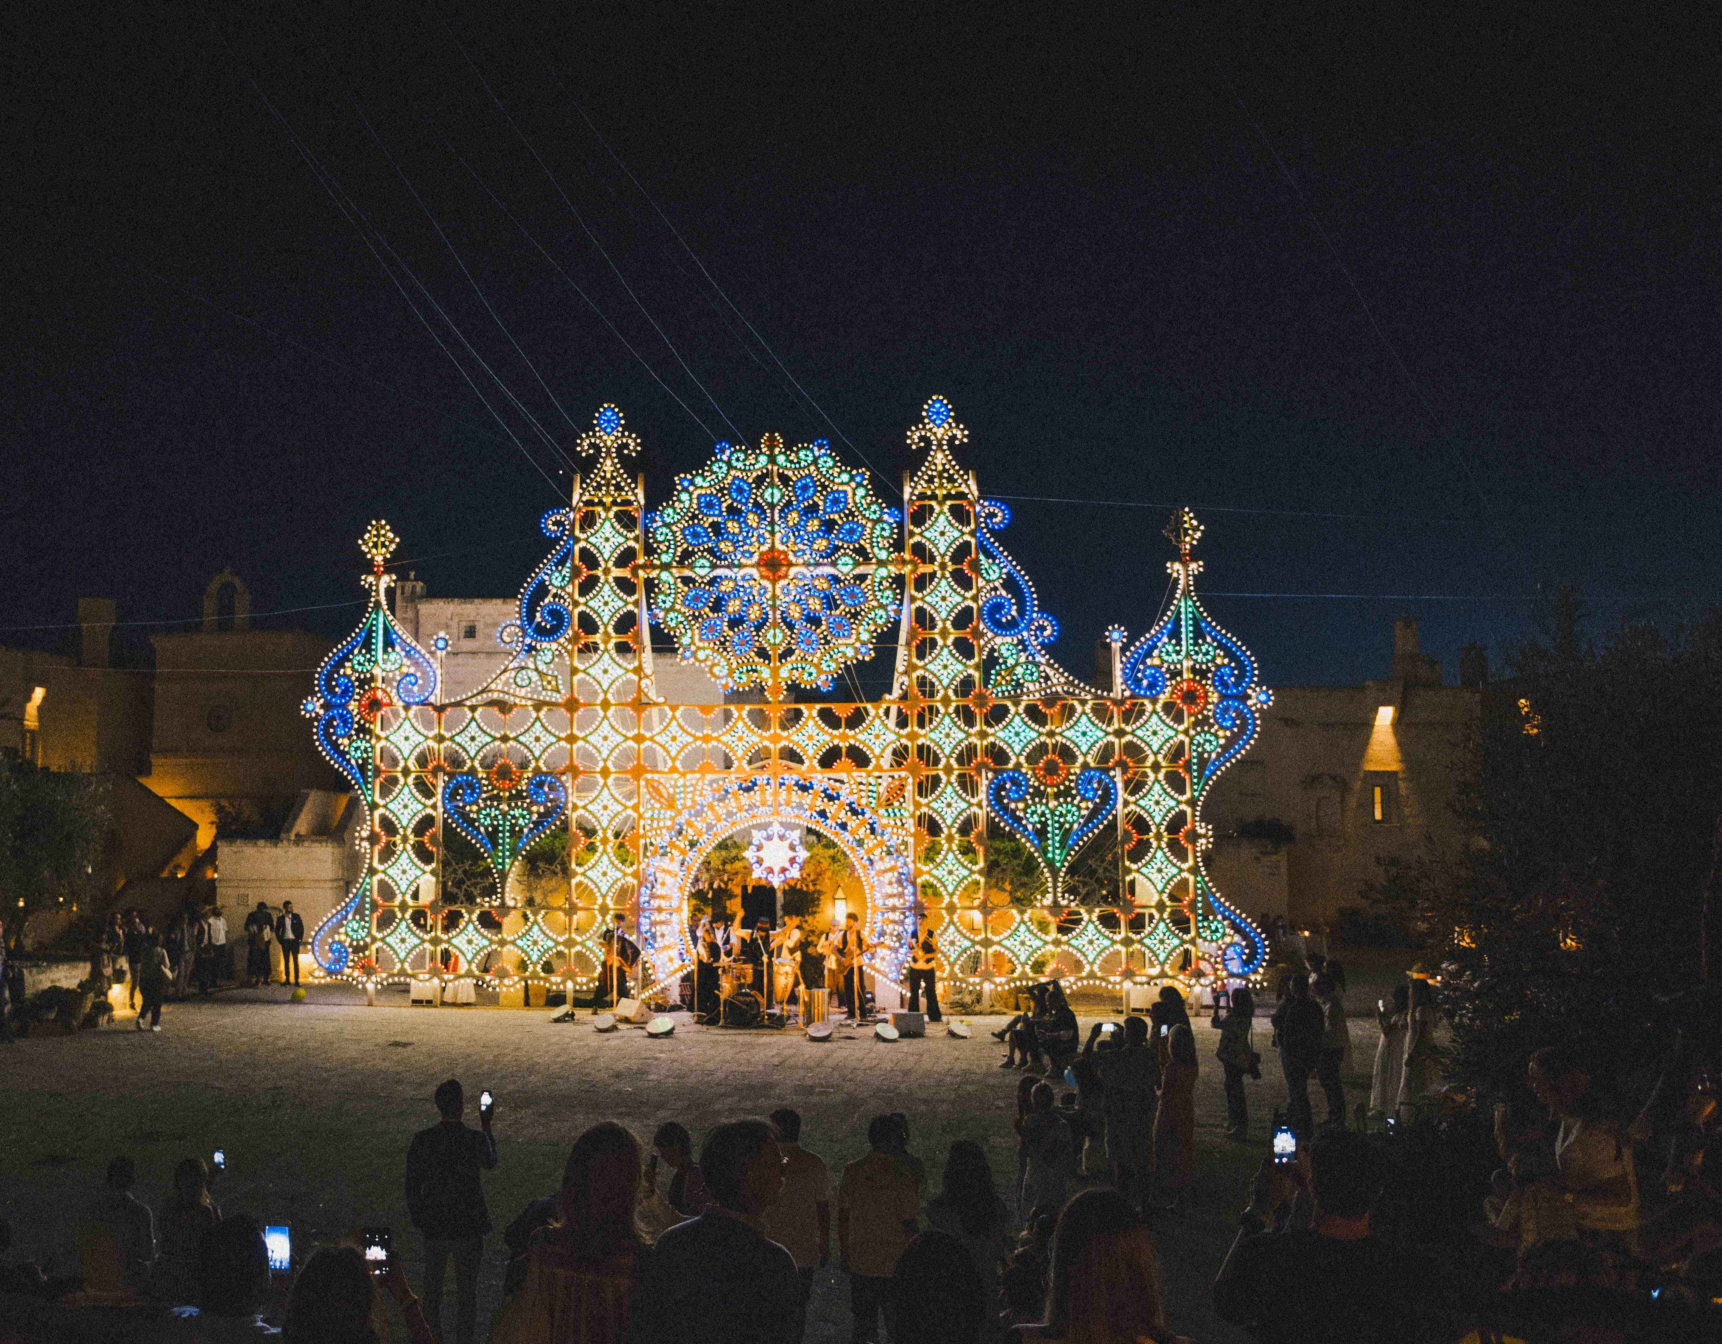
Contact
Sam Sample
+39 080 225 0000
borgo@borgo.com
www.borgoegnazia.com

